Slide 1



Lesson 3 - EV3 Gyro Sensor
Csíkszereda RobotKlub 2024 - mARC NICHITIU - ??

Slide 2
Curriculum
based on the Introduction to Programming EV3 Curriculum developed by Carnegie-Mellon Robotics Academy https://www.cmu.edu/roboticsacademy/roboticscurriculum/index.html
FLL City Shaper Challenge
              https://www.firstinspires.org/resource-library/fll/challenge/challenge-and-resources

Slide 3
Main Goals for Today
Learn about the EV3 Gyro Sensor.
Learn about why we need the Gyro sensor to be precise in FLL.
Learn how to use the EV3 Gyro Sensor to stop at an angle.
Learn how to go straight with the EV3 Gyro Sensor.

Slide 4
Gyro Sensor
The Gyro Sensor measures angles, and can thus measure a difference in angle.
For example, if the robot turns to the right 90°, the gyro would measure 90°.
The gyro can also measure angular speed.
❌
✅
❌
❌

Slide 5
Gyro Sensor - Problems
The Gyro Sensor can sometimes lose precision over time.
It can also start to drift (increase/decrease value very fast without actual robot motion).
To solve these, we have a few hacks :)
First, lets turn for some angle.
❌
✅
❌
❌

Slide 6
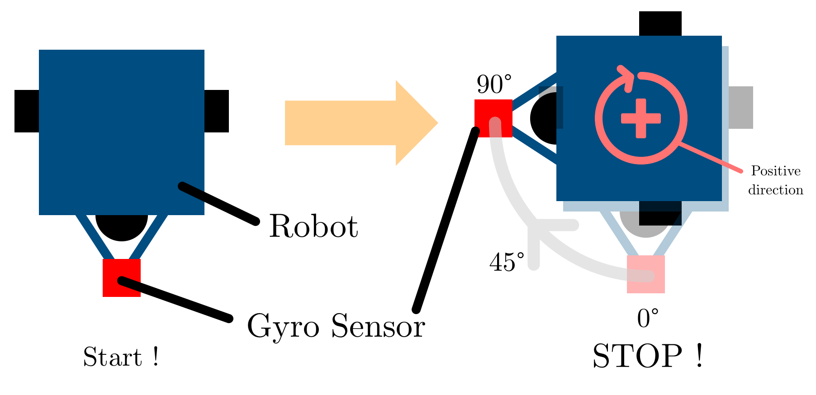
Turning for an Angle - Algorithm
Start the motors to spin the robot
  The robot is now turning
While the robot is turning, use the gyro sensor to check if the angle is big enough (turned enough)
When you hit the angle, stop !
❌
✅
❌
❌

Slide 7
Gyro Sensor - Code
Structure:
  Initialize object/reference to Sensor:
    gyroSensor = GyroSensor(Port.S1)
  Obtain information: .speed(), .angle()
  We will not be using .speed() as it interferes with .angle().
❌
✅
❌
❌

Slide 8
Gyro Sensor - Code - Example
If we wanted to find the gyro’s measured angle, we could write:
gyroSensor = GyroSensor(Port.S1)
ang = gyroSensor.angle()
print(ang)
We will try this in a minute.
❌
✅
❌
❌

Slide 9
Turning for an Angle - Algorithm
Start the motors to spin the robot
  The robot is now turning
While the robot is turning, use the gyro sensor to check if the angle is big enough (turned enough)
When you hit the angle, stop !
❌
✅
❌
❌

Slide 10
Gyro Sensor Program Tutorial
Start with initializing the gyro sensor, on port 1.
# Initialize Gyro Sensor
gyroS = GyroSensor(Port.S1)
❌
✅
❌
❌

Slide 11
Gyro Sensor Program Tutorial
Now, initialize the DriveBase to control the robot’s movement.
# Initialize Gyro Sensor
gyroS = GyroSensor(Port.S1)
# Initialize motors
left_motor = Motor(Port.B)
right_motor = Motor(Port.C)
robot = DriveBase(left_motor,right_motor,wheel_diameter=55.5,axle_track=104)
❌
✅
❌
❌

Slide 12
Gyro Sensor Program Tutorial
Add a command to tell the robot to start driving.
# Initialize Color Sensor
colorS = ColorSensor(Port.S3)
# Initialize motors
left_motor = Motor(Port.B)
right_motor = Motor(Port.C)
robot = DriveBase(left_motor,right_motor,wheel_diameter=55.5,axle_track=104)
robot.drive(0,45) # 0 forward speed, 45 deg/s turning (clockwise)
❌
✅
❌
❌

Slide 13
Gyro Sensor Program Tutorial
Add the while loop. We check at each iteration whether the gyro sensor detected if we turned enough. If not, run the loop. If turned enough, stop. Inside the loop, place a time.sleep command to not abuse the robot computer. Don’t forget the import time command before the loop.
...
robot.drive(0,45) # 0 forward speed, 45 deg/s turning (clockwise)
import time
# while I have not yet turned 90°
while(gyroS.angle() < 90):
time.sleep(0.01)
❌
✅
❌
❌

Slide 14
Gyro Sensor Program Tutorial
If the angle is reached, the loop exits. Thus, we tell the robot to stop driving.
...
robot.drive(0,45) # 0 forward speed, 45 deg/s turning (clockwise)
import time
# while I have not yet turned 90°
while(gyroS.angle() < 90):
time.sleep(0.01)
robot.drive(0,0)
robot.stop()
# end of program.
❌
✅
❌
❌

Slide 15
Gyro Sensor Program Tutorial
Full Program:
#!/usr/bin/env pybricks-micropython
from pybricks.hubs import EV3Brick
from pybricks.ev3devices import (Motor, TouchSensor, ColorSensor,InfraredSensor, UltrasonicSensor, GyroSensor)
from pybricks.parameters import Port, Stop, Direction, Button, Color
from pybricks.tools import wait, StopWatch, DataLog
from pybricks.robotics import DriveBase
from pybricks.media.ev3dev import SoundFile, ImageFile
import time
# Create your objects here.
ev3 = EV3Brick()
# Initialize Color Sensor
gyroS = GyroSensor(Port.S1)
# Initialize motors
left_motor = Motor(Port.B)
right_motor = Motor(Port.C)
robot = DriveBase(left_motor,right_motor,wheel_diameter=55.5,axle_track=104)
robot.drive(0,45) # 0 forward speed, 45 deg/s turning (clockwise)
# while I have not yet turned 90°
while(gyroS.angle() < 90):
time.sleep(0.01)
robot.drive(0,0)
robot.stop()
# end of program.
❌
✅
❌
❌

Slide 16
Lets test it
Run your program !!
❌
✅
❌
❌

Slide 17
Problems
Question: What if my robot stops late ?
  Answer: Decrease the threshold of 90° to 87° or 85°, or lower the speed.
Question: What if my robot misses the angle ?
  Answer: Check that the gyro sensor is not drifting.
❌
✅
❌
❌

Slide 18
Problems - Drifting Gyro - 1
If the gyro is drifting (changing value rapidly for no reason), we can do two things:
  We can recalibrate it by asking for a speed and then an angle:
  gyroS = GyroSensor(Port.S1)
  gyroS.speed()
  gyroS.angle()
  # done
❌
✅
❌
❌

Slide 19
Problems - Drifting Gyro - 2
If the gyro is drifting (changing value rapidly for no reason), we can do two things:
  We can also tell the EV3 to ask for the wrong sensor, and then the correct one:
  try:
  tmp = UltrasonicSensor(Port.S1) # temporary wrong sensor
  tmp.distance() # asking for the wrong data
  except:
  print("failed")
  gyroS = GyroSensor(Port.S1)
  gyroS.angle()
  # done
❌
✅
❌
❌

Slide 20
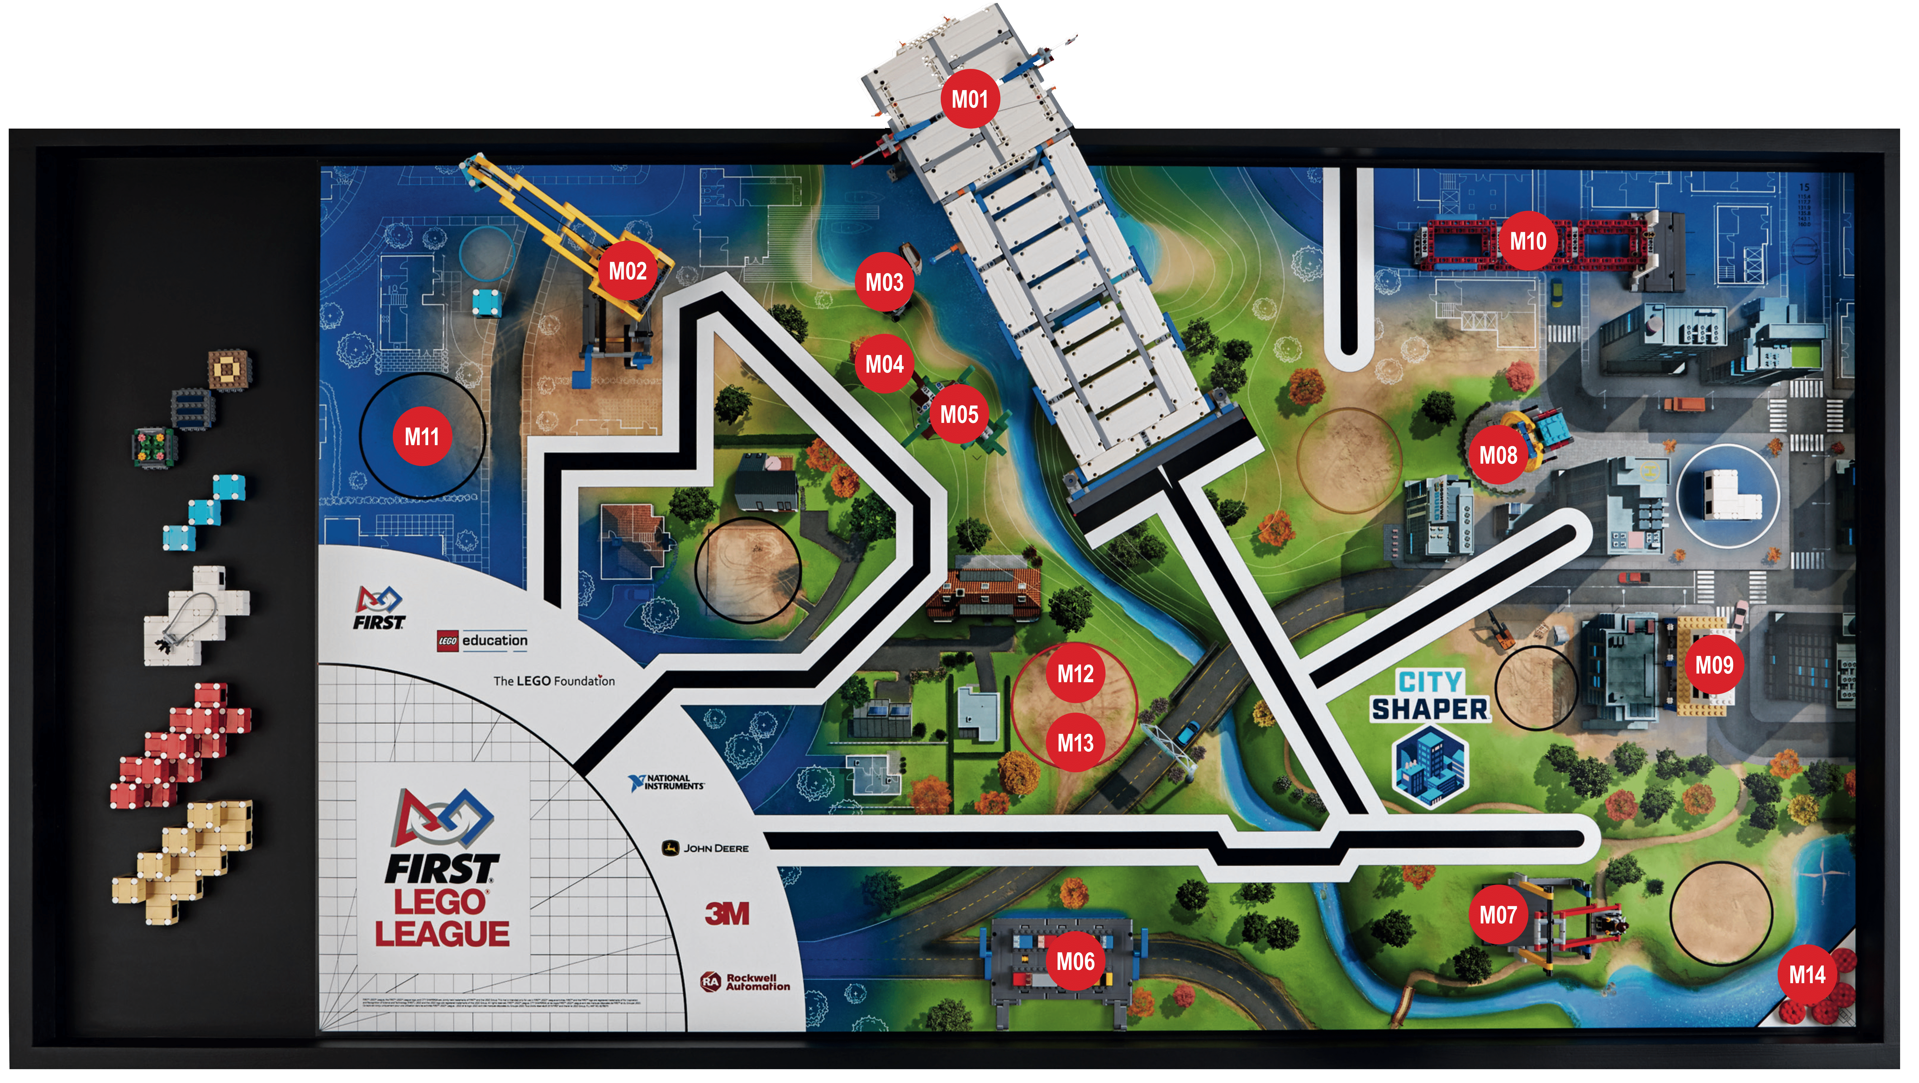
How is this useful ??
We have to go long distances on the field….

Slide 21
How is this useful ??
If the robot moves straight, it shouldn’t change its angle right ?

Slide 22
How is this useful ??
Lets follow an ‘angle’ across the table !

Slide 23
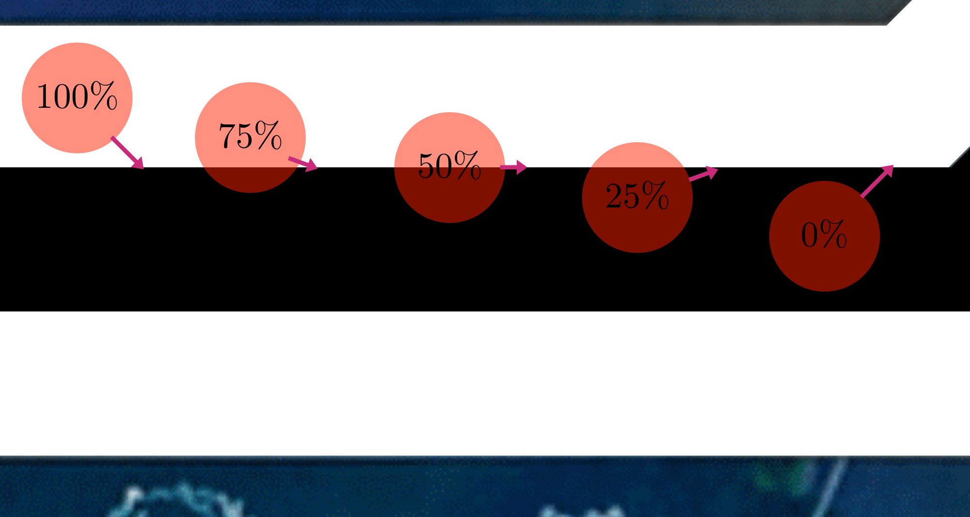
Line Following - Gyro
Let’s remember from last time how we followed lines.
We followed the edge of the line, where the sensor read 50.

Slide 24
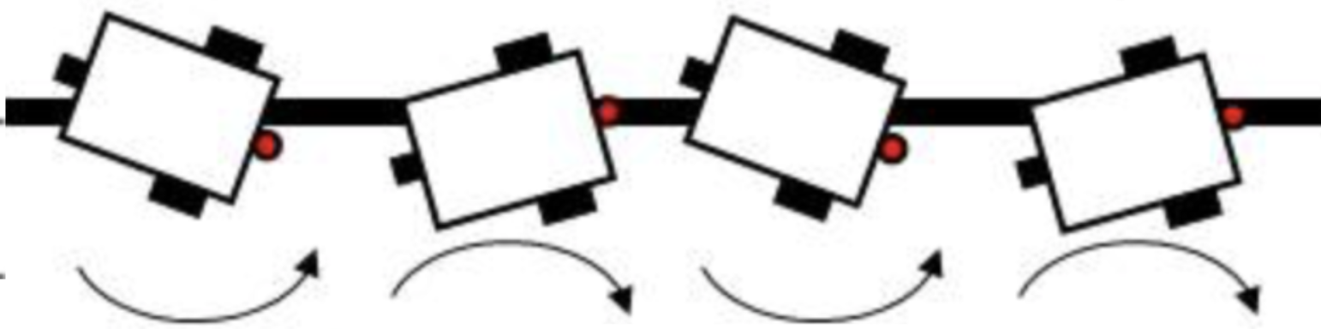
Line Following - Gyro
This time, we’ll follow the actual imaginary line, where the gyro will always read the same thing.
We first store the initial value, and then follow that !

Slide 25
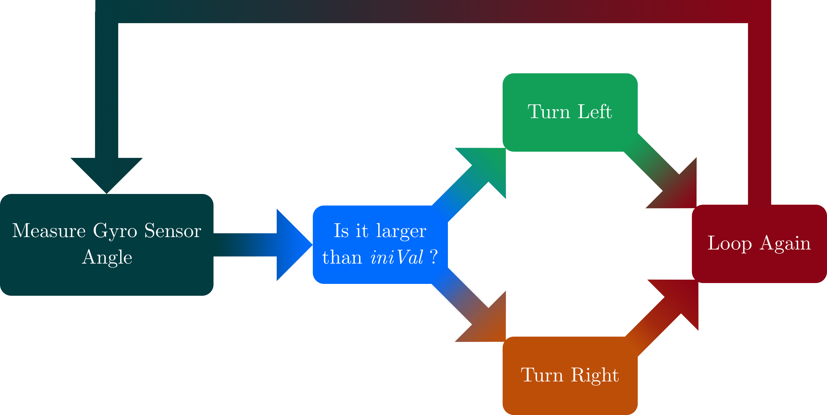
Line Following - Algorithm - Boolean

Slide 26
Line Following - Boolean
In python, we would have (after the initial part):
# Initialize Gyro Sensor
gyroS = GyroSensor(Port.S1)
robot.drive(250,0) # 250 mm/s speed, 0 turning (straight)
iniAng = gyroS.angle() # Initial heading
# while I have not yet covered my distance
while(robot.distance() < 200): # 200 mm = 20 cm
ang = gyroS.angle() # measure
  if(ang > 0): # to the right
  robot.drive(250,-20) # turn left
    else: # on black
      robot.drive(250,20) # turn right
time.sleep(0.01) # wait a little
robot.drive(0,0)
robot.stop()
# end of program.

Slide 27
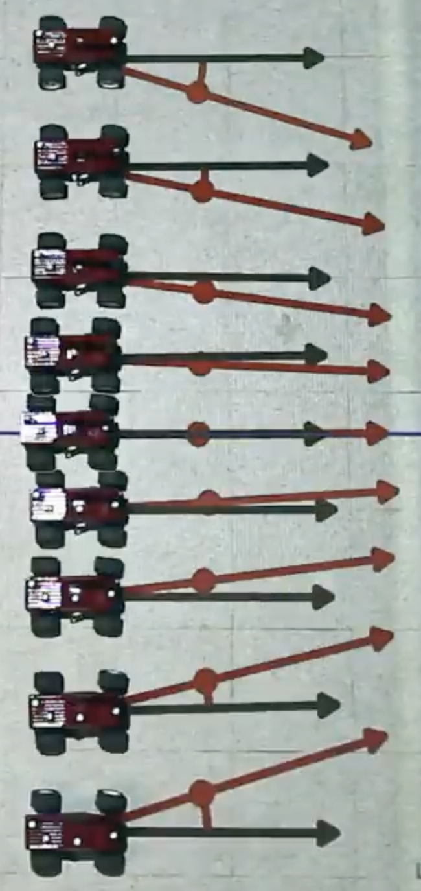
Line Following - Algorithm - Proportional
We can do better, just like for the colors !!
We can steer less if we are closer, and steer more if we are farther.
❌
✅
❌
❌

Slide 28
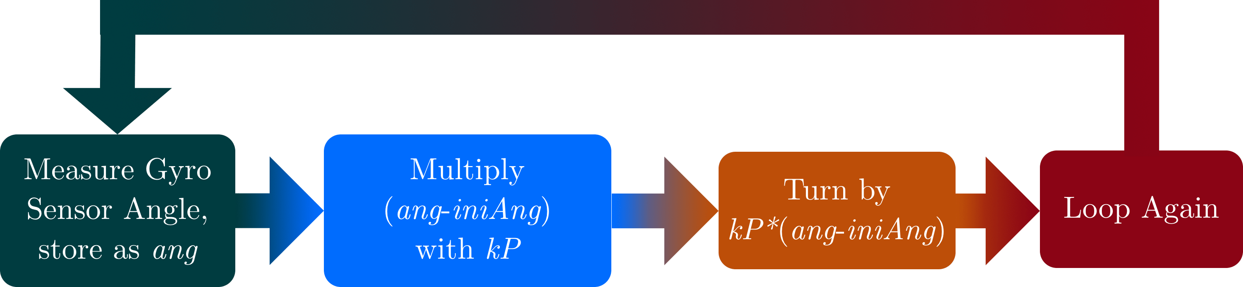
Line Following - Algorithm - Proportional

Slide 29
Line Following - Proportional
In python, we would have (after the initial part):
# Initialize Gyro Sensor
gyroS = GyroSensor(Port.S3)
robot.drive(250,0) # 250 mm/s speed, 0 turning (straight)
kP = 1 # Proportional Constant
iniAng = gyroS.angle() # Initial heading
# while I have not yet covered my distance
while(robot.distance() < 200): # 200 mm = 20 cm
ang = gyroS.angle() # measure
  err = iniAng-ang # positive error is to the left
      robot.drive(250, err*kP) # turn by err*kP
time.sleep(0.01) # wait a little
robot.drive(0,0)
robot.stop()
# end of program.

Slide 30
Line Following - Algorithm - PD
We can still do better, just like for the colors !!
What if we changed direction slower ?
Derivative: change of some quantity over time
  Lets use it !
❌
✅
❌
❌

Slide 31
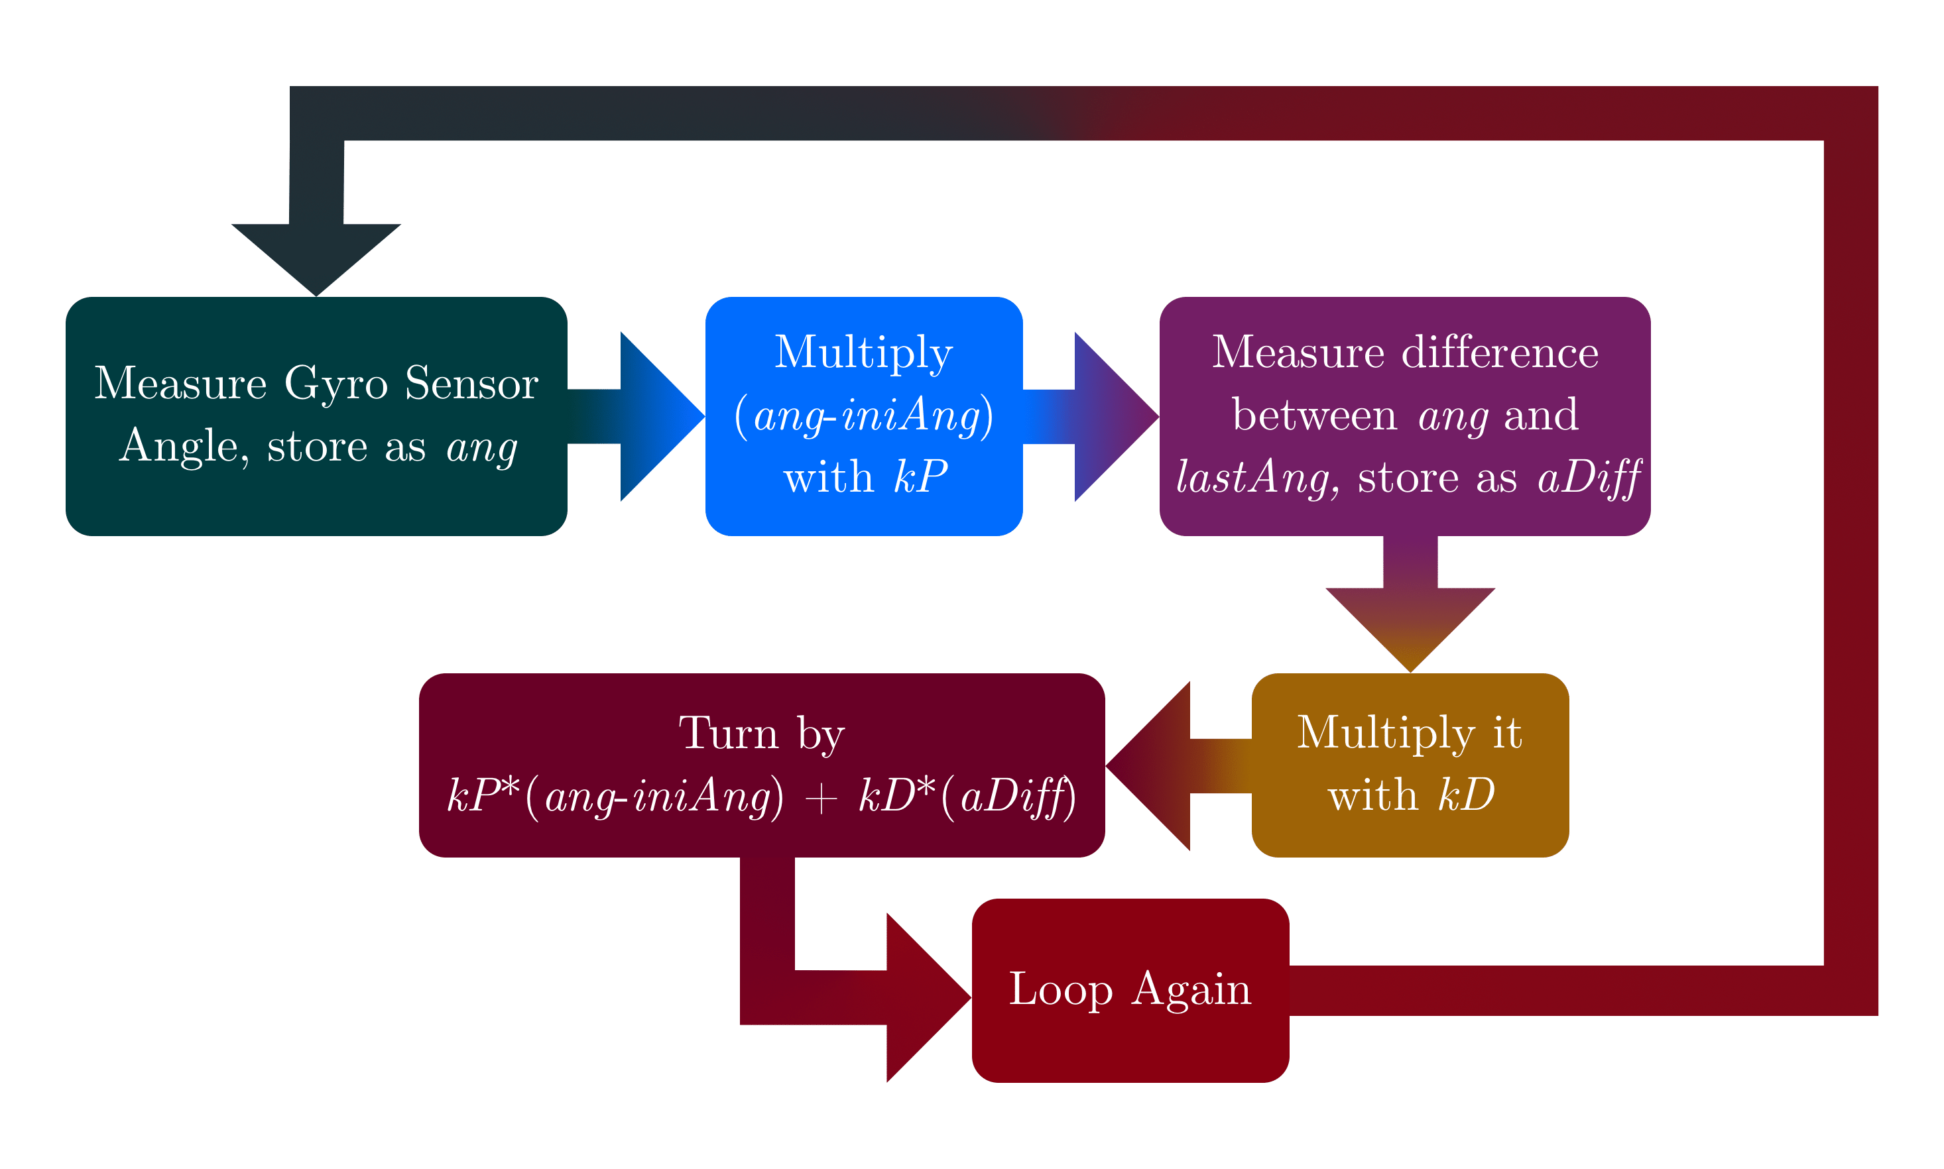
Line Following - Algorithm - PD

Slide 32
Line Following - PD
In python, we would have (after the initial part):
# Initialize Gyro Sensor
gyroS = GyroSensor(Port.S3)
robot.drive(250,0) # 250 mm/s speed, 0 turning (straight)
kP = 1 # Proportional Constant
kD = 0.1 # Derivative Constant
iniAng = gyroS.angle() # Initial heading
lastAng = iniAng
# while I have not yet covered my distance
while(robot.distance() < 200): # 200 mm = 20 cm
ang = gyroS.angle() # measure
aDiff = ang-lastAng # get difference
  err = iniAng-ang # positive error is to the left
      robot.drive(250, err*kP + aDiff*kD) # turn by err*kP
time.sleep(0.01) # wait a little
robot.drive(0,0)
robot.stop()
# end of program.

Slide 33
Lets test it
Run your program !!
❌
✅
❌
❌

Slide 34
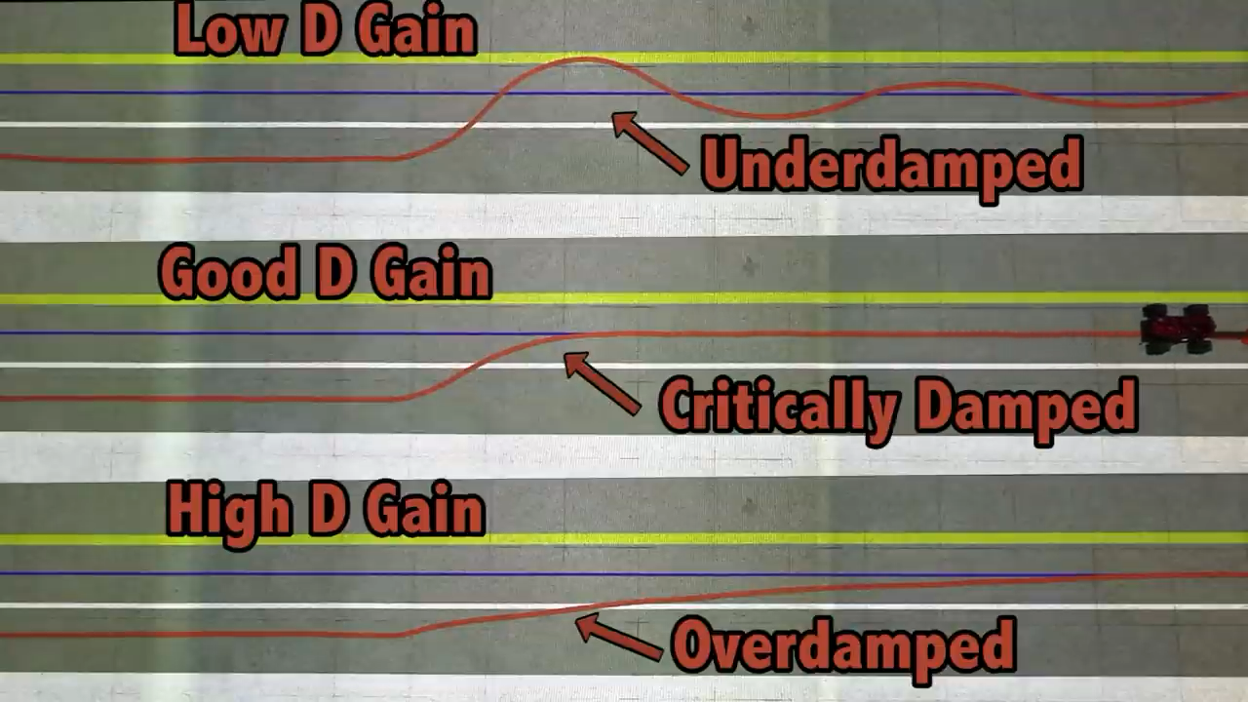
Animation - kD = ‘D Gain’
❌
✅
❌
❌

Slide 35
Problems
It doesn’t change anything :(
  Solution: increase kD!
It is too slow to correct for a bump in the path :(
  Solution: decrease kD!
❌
✅
❌
❌

Slide 36
End
See you next time !
Never hesitate for questions.

